Slide 1

DBMS
INTERVIEW QUESTIONS AND ANSWERS

Slide 2




3-TIERED ARCHITECTURE
APPLICATION SERVER
CLIENT
(ie,chrome,firefox)
DATABASE
(Apache,NGINX,IIS etc. with ASP,NET,Java EE,etc)

Slide 3


DIFFERENCE BETWEEN DBMS & RDBMS
DBMS
RDBMS
Provides an organized way of managing ,retrieving, and storing from a collection of logically related information
Provides the same as that of DBMS, but it provides relational integrity

Slide 4
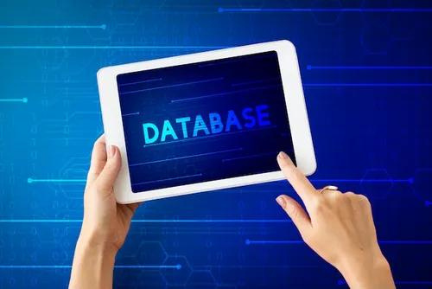

EXPLAIN DATABASE
A software application that interacts with databases, application, and users to capture and analyze the required data. The data stored in the database can be retrieved, deleted and modified based on the client’s requirement.

Slide 5

TYPES OF DBMS
1
2
3
4
RELATIONAL
HIERARCHICAL
NETWORK
OBJECT-ORIENTED
This type of DBMS, uses a structure which allows the users to access data in relation to another piece of data in a database. In this type of DBMS, data is stored in the form of tables.
As the name suggests, this type of DBMS has a structure similar to that of a tree, wherein the nodes represent records and the branches of the tree represent fields.
This type of DBMS supports many-to-many relations wherein multiple member records can be linked.
Uses small individual software called object to store pieces of data and the instruction for the actions to be done with the data.

Slide 6
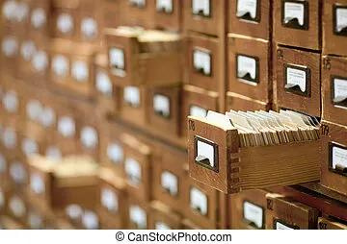

ADVANTAGES
01
SHARING OF DATA
04
DATA INDEPENDENCE
02
INTEGRITY CONSTRAINTS
05
PROVIDE BACKUP AND RECOVERY FACILITY
03
REDUNDANCY CONTROL
06
APPLICATION DEVELOPMENT

Slide 7
LANGUAGES IN DBMS
1.
2.
3.
4.
DDL consists of commands which are used to define database.
DML consists of commands which are used to manipulate the data present in the database.
DCL consists of commands which deal with the user permission and controls of the database system.
TCL consists of commands which deal with the transaction of the database.
DDL
DML
DCL
tcL
( Data Definition Language )
( Data Manipulation
Language )
( Data Control Language )
( Transaction Control Language )

Slide 8
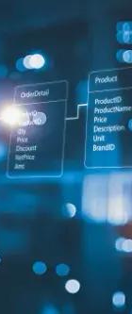
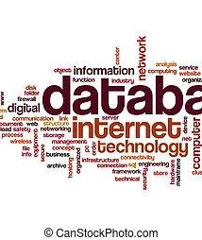
QUERY OPTIMIZATION
Query optimization is the phase that identifies a plan for evaluation query that has the least estimated cost. This phase comes into the picture when there are a lot of algorithms and methods to execute the same task.
The advantages of query optimization are as follows:
The output is provided faster.
A large number of queries can be executed in less time.
reduces time and space complexity.

Slide 9
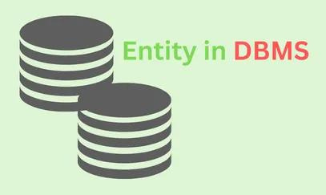
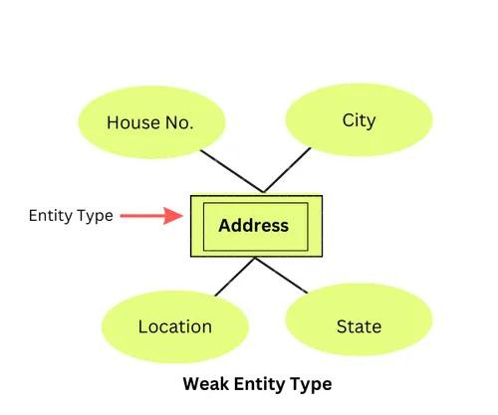
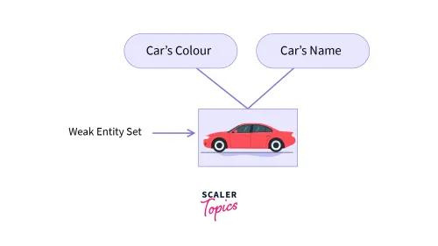
TERMS IN DBMS
ENTITY
ENTITY TYPE
ENTITY SET
An entity is a real-world object having attributes, which are nothing but characteristics of that particular object. For example, an employee can be an entity. This particular entity can have attributes such as empid, empname, etc.
Entity type is nothing but a collection of entities, having the same attributes. Generally, an entity refers to one or more related tables in a particular database. So, you can understand, entity type as a characteristic which uniquely identifies the entity. For example , An employee can have attributes such as empid, empname, department, etc.
An entity set is collection of all the entities of a particular entity type in a database. For example, a set of employees, a set of employees, a set of companies, and a set of people can come under an entity set.

Slide 10
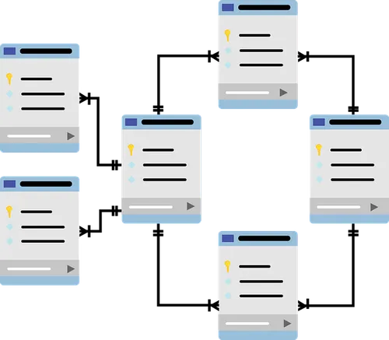
ENTITY-RELATIONSHIP MODEL
It is a diagrammatic approach to database design, where you represent real-world objects as entities and mention relationships between them. This approach helps the team of DBA’s to understand the schema easily.

Slide 11





LET'S
WORK
TOGETHER
TO CRACK
INTERVIEW
THANK YOU!
@Imdeveloper2910
@imdeveloperhd1
@Imdeveloper2910

